Slide 1
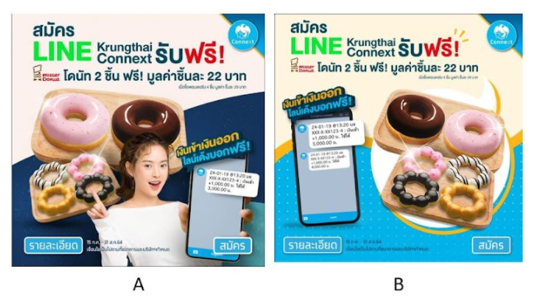
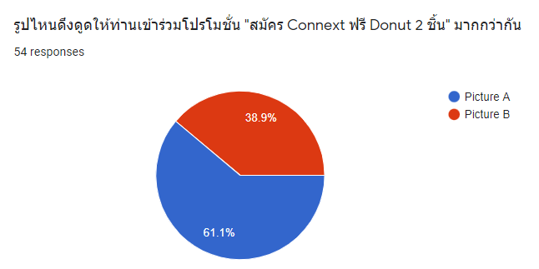
A/B Test
“Apply for LINE Connext, Free 2 Donuts”.
Findings
56 Participants prefer “A” than “B”
However, Goodness of Fit test found that the proportion is not different from 50:50 where Chi-square = 0.51, P-value = 0.69 at significant level of 0.05
Homogeneity test using Chi-square test on “gender”, “age”, and “like/dislike donut” found that the proportion of preference are not different in each features at significance level of 0.05
Parameter | Gender | Age | like/dislike donut
Chi-square | 2.23 | 6.41 | 0.10
P-value | 0.32 | 0.09 | 0.74

